Slide 1

MICRO CREDIT DEFAULTER
Presented By:
NITISH KUMAR SHARMA

Slide 2
INTRODUCTION
A Microfinance Institution (MFI) is an organization that offers financial services to low income populations.
MFS becomes very useful when targeting especially the unbanked poor families living in remote areas with not much sources of income.
Today, microfinance is widely accepted as a poverty-reduction tool, representing $70 billion in outstanding loans and a global outreach of 200 million clients. We are working with one such client that is in Telecom Industry. They are a fixed wireless telecommunications network provider.
They are collaborating with an MFI to provide micro-credit on mobile balances to be paid back in 5 days. The Consumer is believed to be defaulter if he deviates from the path of paying back the loaned amount within the time duration of 5 days.
For the loan amount of 5 (in Indonesian Rupiah), payback amount should be 6 (in Indonesian Rupiah), while, for the loan amount of 10 (in Indonesian Rupiah), the payback amount should be 12 (in Indonesian Rupiah). The sample data is provided to us from our client database.

Slide 3
PROBLEM STATEMENT
In order to improve the selection of customers for the credit, the client wants some predictions that could help them in further investment and improvement in selection of customers.
Build a model which can be used to predict in terms of a probability for each loan transaction, whether the customer will be paying back the loaned amount within 5 days of insurance of loan.
The objective is to study the behaviour of defaulters as well as prepare a machine learning model to classify all defaulters using the sample dataset provided by the client.

Slide 4
EDA STEPS
We will start by importing the libraries that we require for performing EDA. These include NumPy, Pandas, Matplotlib, and Seaborn.
We will now read the data from a CSV file into a Pandas DataFrame.
We will display top 5 rows by using .head() function to know if it has the right type to data in it or not.
Using .shape function to display total number of rows and columns present in the dataset.
Using .columns function to display all the features name present in the dataset.
We will now check datatype of each features by using .info() function.
We will now display number of unique values in each features by using .nunique() function.
Then listing out categorical and continuous features from dataset.
Use describe() function to get statistical details like count, percentiles, mean, std, and maximum value of a data frame.
We will now check for null values in our dataset. We will use isnull().sum() function for this purpose. But the dataset does not have any null values.
Now we will do univariate, bivariate analysis on data to extract information from it.

Slide 5
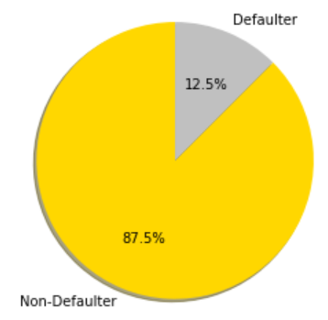
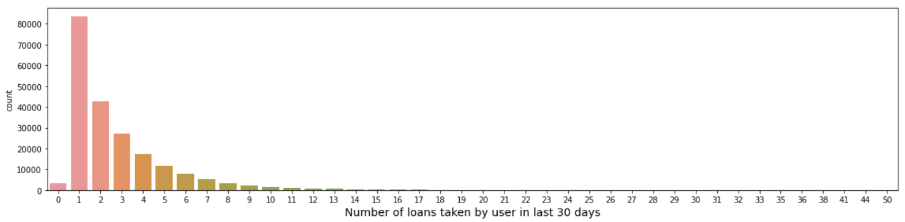
VISUALIZATION
Using countplot function from seaborn library to visualize features which gives insights about the data.
Writing down inferences for each plot of univariate analysis.
The pie chart here depicts the percentage of defaulter and non-defaulter users.
The bar chart shows the number of times the user has taken loan in last 30 days.

Slide 6
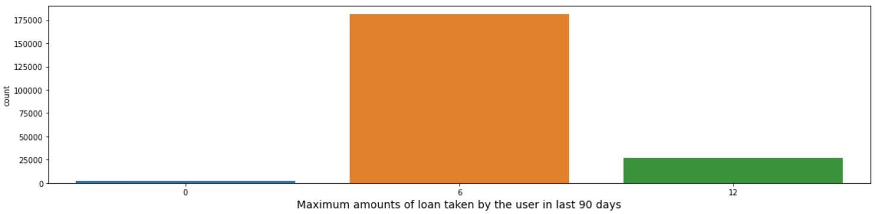
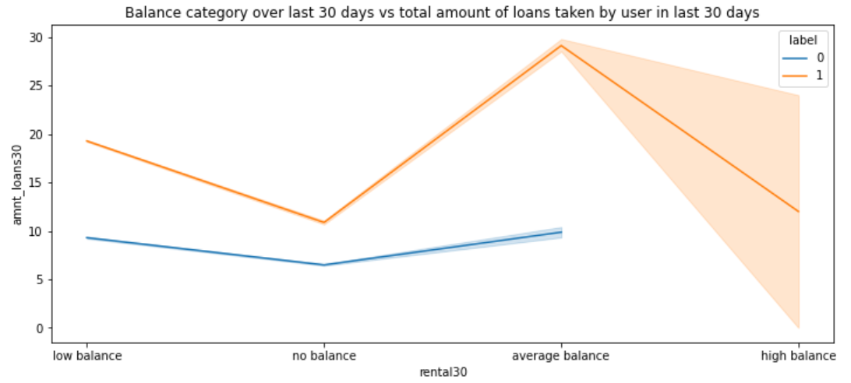
Users have taken 6 times loan most of the time in 90 days period.
Users who take less amount of loans are in defaulter list as they fail to repay within the stipulated time.

Slide 7
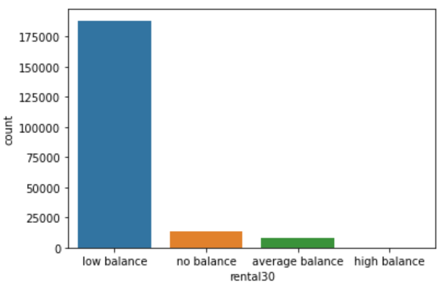
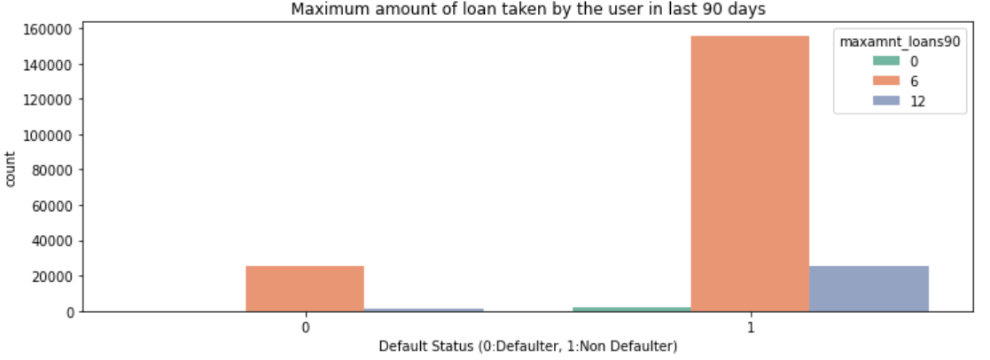
Mostly users maintain low balance. Only few of the users maintains average balance.
There is less case of defaulter if the period of loan is 90 days.

Slide 8
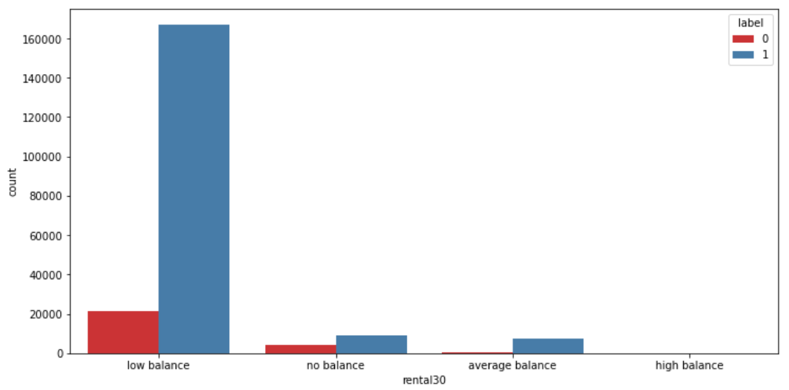
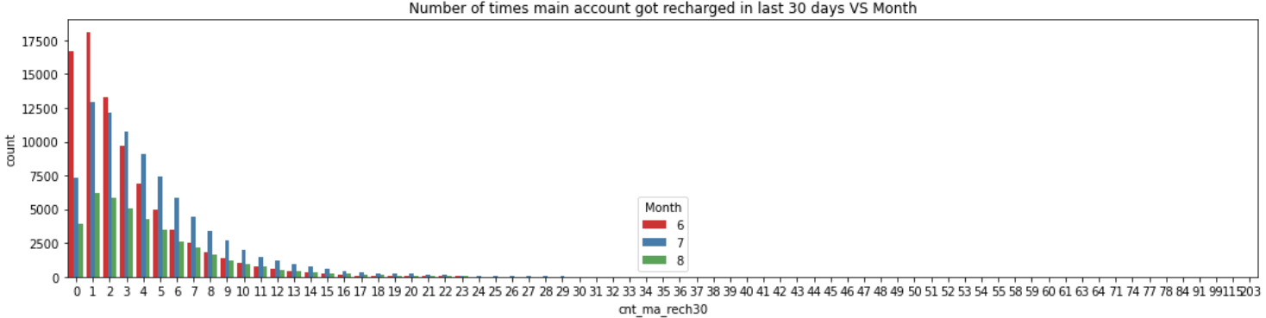
Lots of users those who are maintaining low balance is in defaulter list.
According to the plot, maximum times users recharge their account in the month of July followed by then June
.

Slide 9
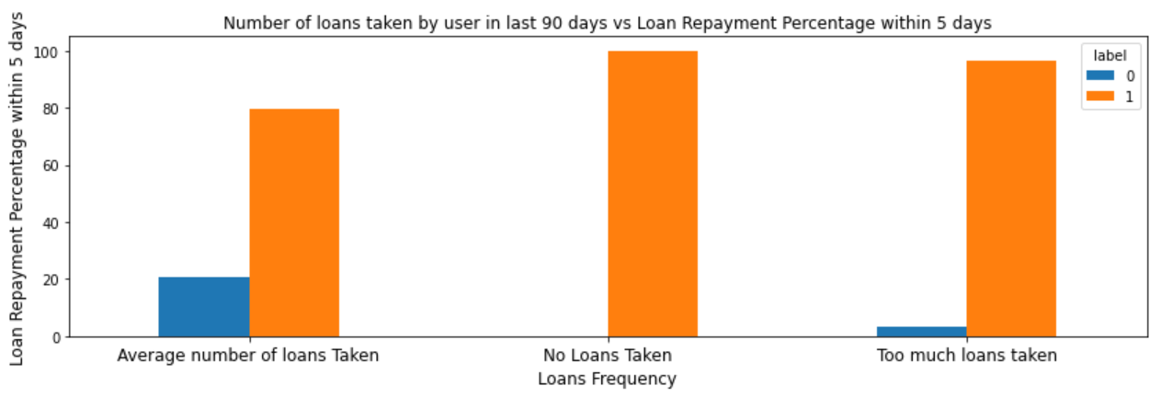
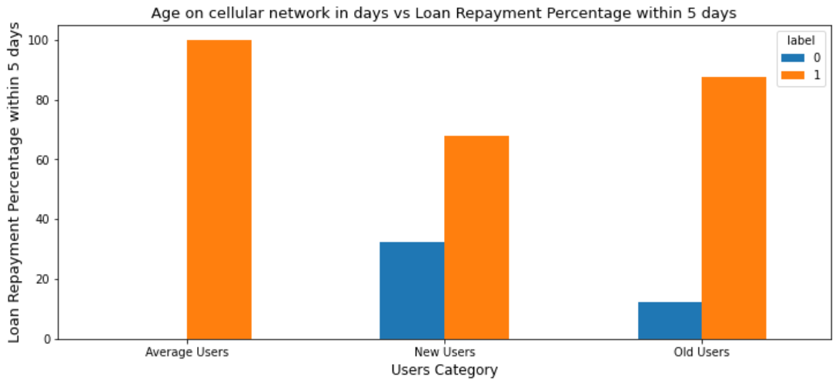
Around 98% Users taking too much loans are non-defaulters as they repay the loan within stipulated time. Users taking average number of loans which is approx 20% are defaulters.
New Users category has lots of defaulters around 35%.

Slide 10
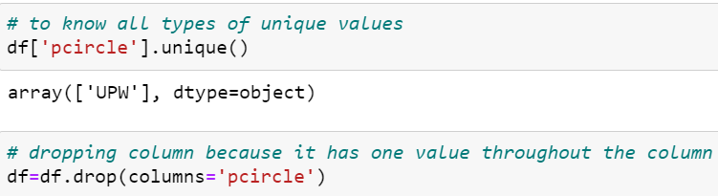
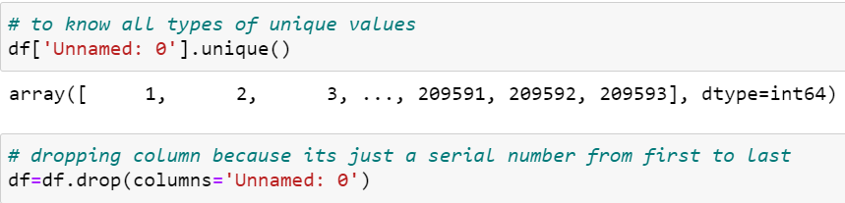
DATA CLEANING

Slide 11
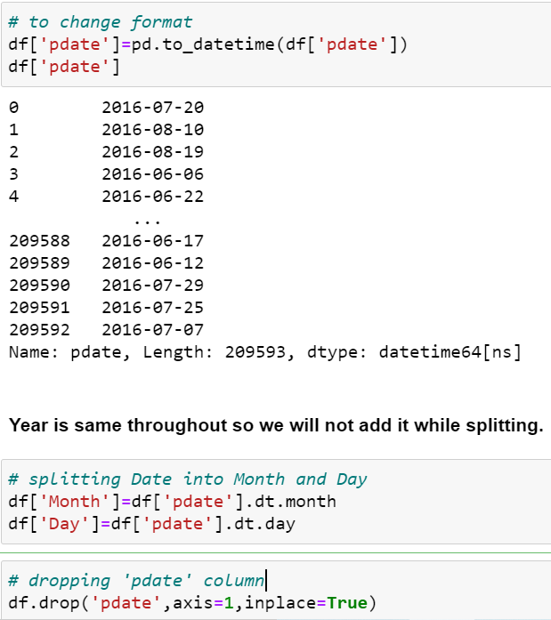
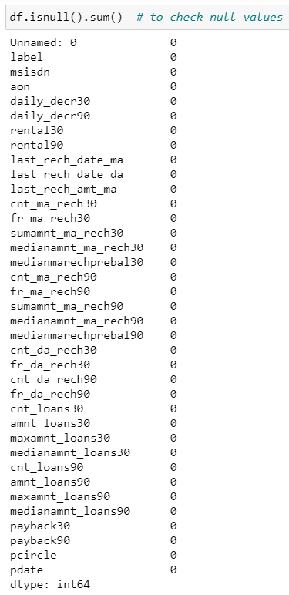

Slide 12
STEPS & ASSUMPTIONS TAKEN
After data cleaning, distplot was created for all features. Almost all the features were right skewed.
Then visualized the features using boxplot and all the features were having outliers.
So treated the features using 1.5 IQR method and again visualized the features using boxplot.
Then checked for skewness but did not treat the skewness using log transformation or any method as we don’t want to lose data more than 7-8%.
Plotted heat map to see the correlation of features with the target variable.
Then removed features from the data that were highly co-related to each other by observing it through variance inflation factor.
Then started model building and testing with different algorithms to find best model and finally doing hyper parameter tuning to achieve good accuracy.

Slide 13
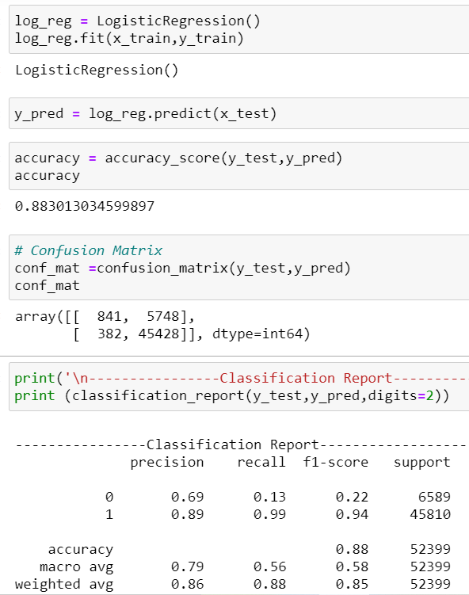
MODEL DASHBOARD
1. LOGISTIC REGRESSION

Slide 14
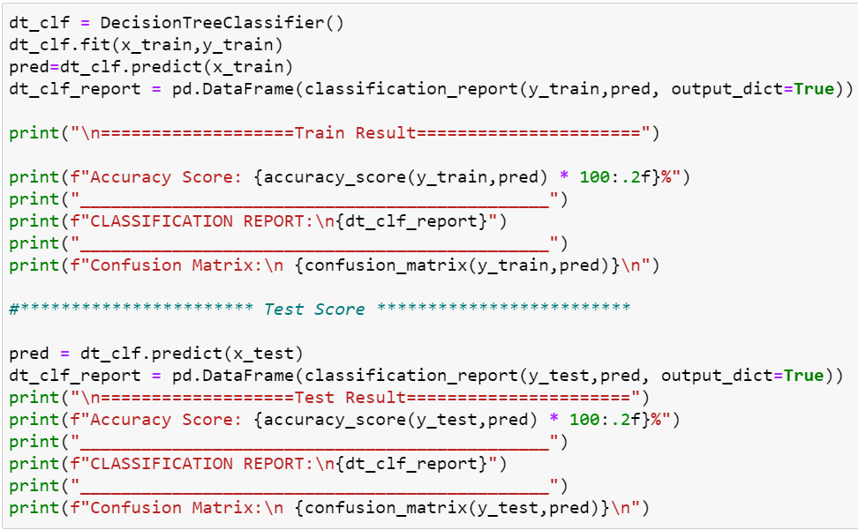
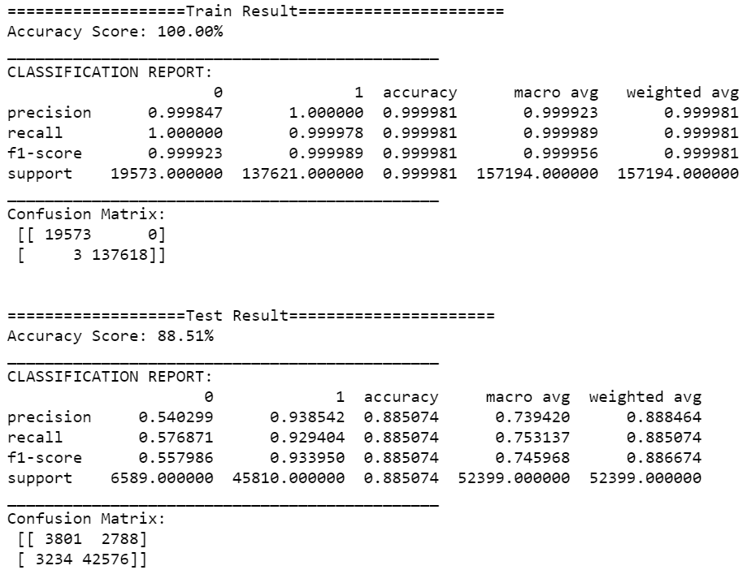
2. DECISION TREE CLASSIFIER

Slide 15
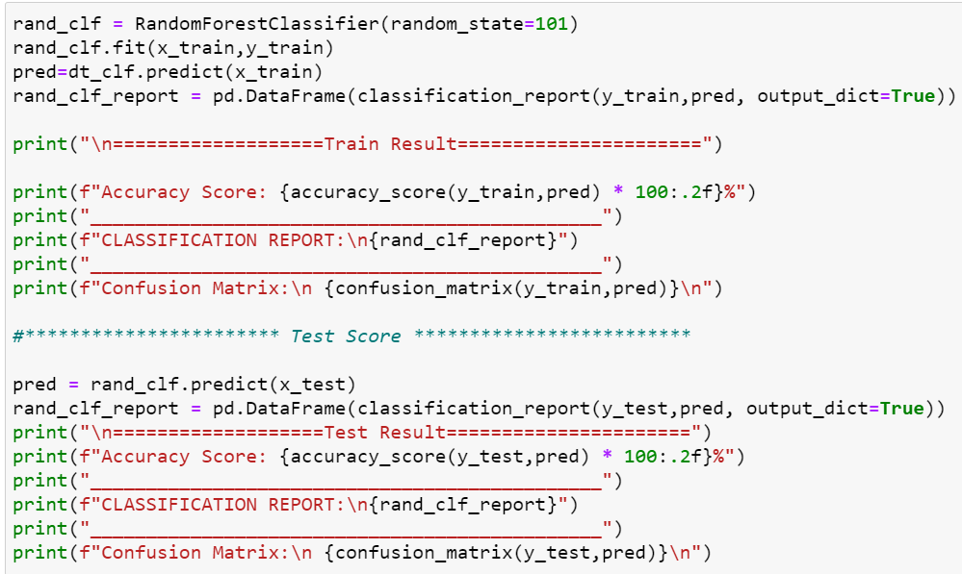
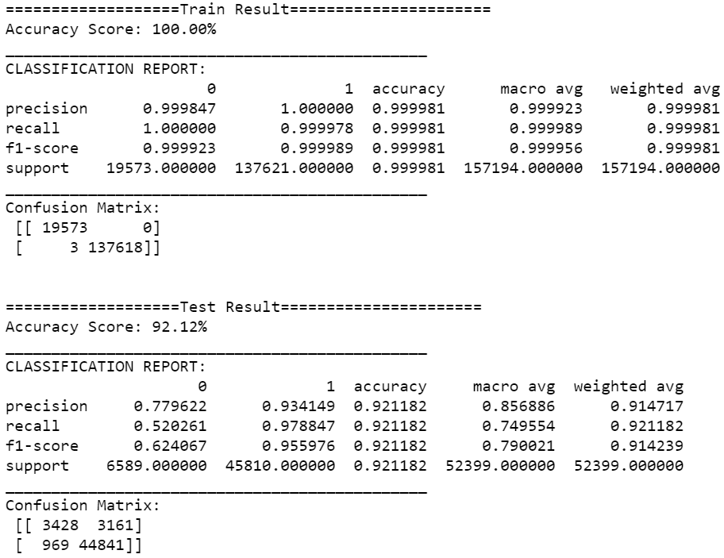
3. RANDOM FOREST CLASSIFIER

Slide 16
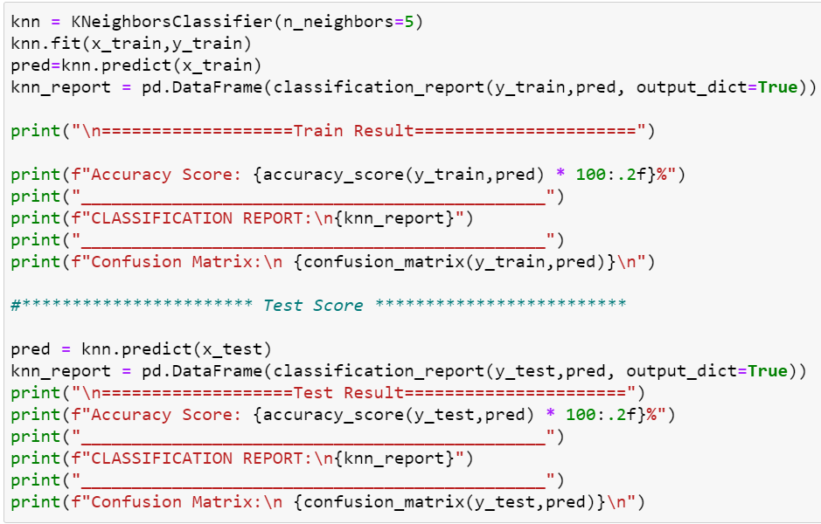
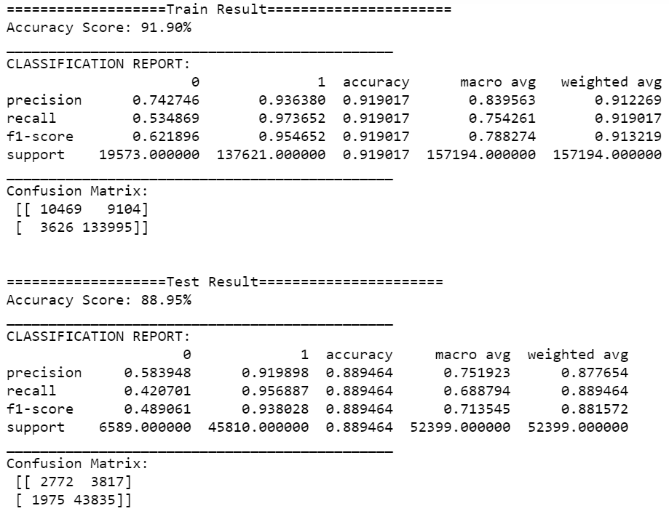
4. KNN CLASSIFIER

Slide 17
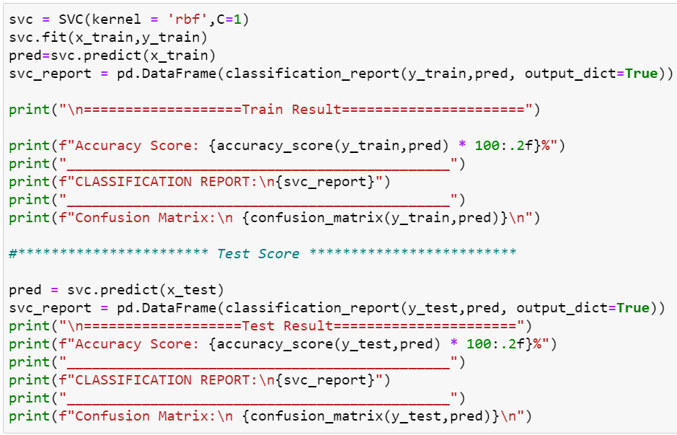
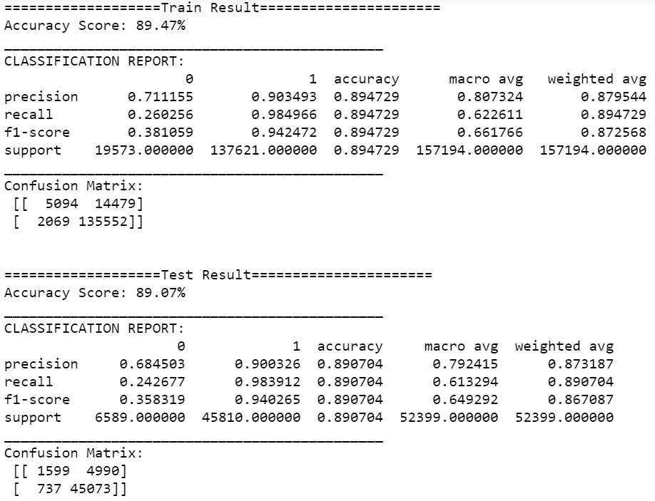
5. SUPPORT VECTOR MACHINES

Slide 18
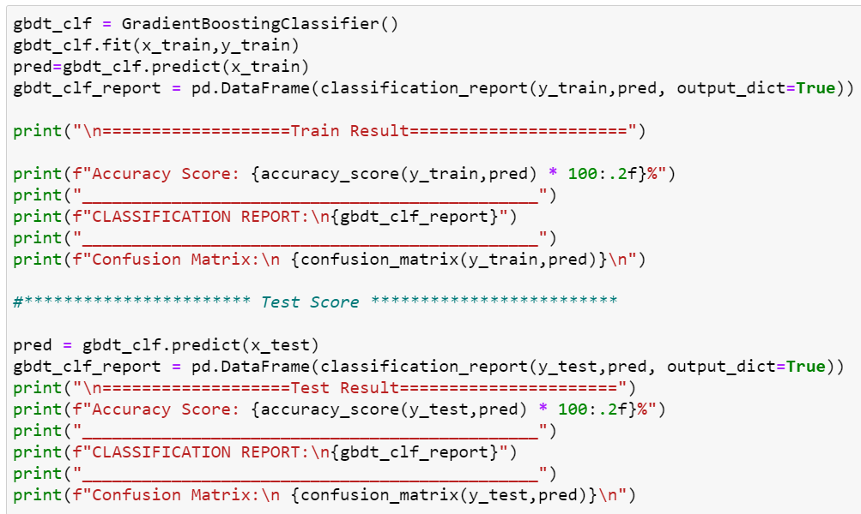

6. GRADIENT BOOSTING CLASSIFIER

Slide 19
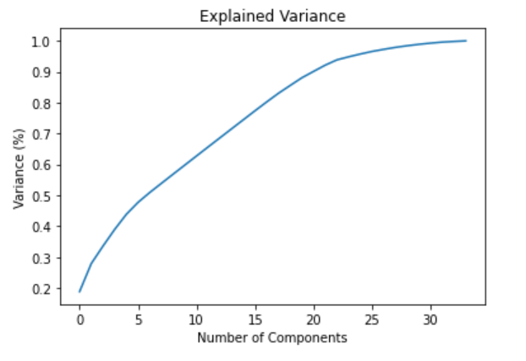
We can see that 95% of the variance is being explained by 25 components by applying PCA which reduces the dimensionality of large datasets.
PRINCIPAL COMPONENT ANALYSIS (PCA)

Slide 20
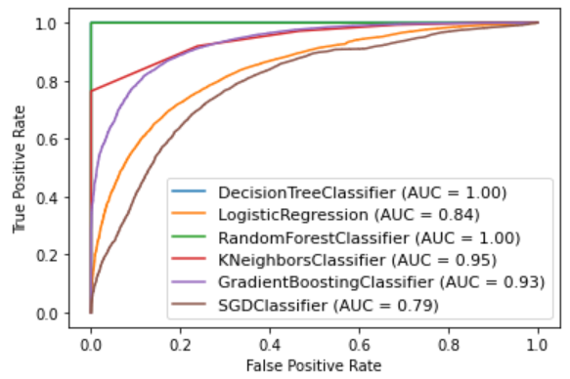
ROC-AUC CURVE FOR ALL MODELS
The higher the AUC, the better the performance of the model at distinguishing between the positive and negative classes.
From the above graph it is clear that Random Forest and Decision Tree Classifier are the best model.

Slide 21
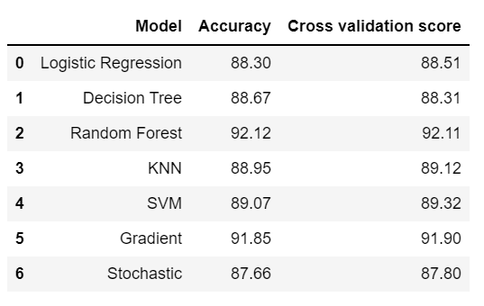
FINALIZED MODEL
Random Forest Classifier is our best/finalized model to deploy for production because the difference between its accuracy and CV score is least among all models.

Slide 22
CONCLUSION
1) The analysis showed that loans frequency, cnt_loans30 & 90, amnt_loans30 and cnt_ma_rech30 & 90 were important determinants of target (defaulter/non-defaulter) variable.
2) Around 35% of new users falls into defaulter category. This shows the flickering mindset of new users of not paying back the loan amount within stipulated time.
3) Users taking loans in last 30 days has more defaulters than taking loans in last 90 days.
4) Mostly users maintaining low balance is in defaulter list.
5) Users consider to take loan amount of Rupiah 5 mostly where the payback loan amount is Rupiah 6 than the loan amount of Rupiah 10 where the payback loan amount is Rupiah 12. This depicts that they use mobile balance precisely.
6) Users taking average number of loans are more in defaulter count than users taking too much of loans.
7) Users maintaining high balance pay their loans on the stipulated time. That’s why non-defaulter ones of them is 99%.
8) The % of number of times of loan taken in last 30 days by users keeps on decreasing.
9) Users taking average number of loans which is approx 20% are defaulters.

Slide 23
THANK YOU !!

